Slide 1
Phoebe A. Hearst Elementary
August
2020
Our Distance Learning Plan

Slide 2
Engagement
Every kid needs a champion | Rita Pierson

Slide 3
Daily Live Instruction/Schedules
Return to Learn Plan
Daily Live Instruction SB 98
Bulk of Synchronous instruction will be between 8:00-12:00
Focus on Essential Standards ELA & Math
Enrichment – PE (1-6), Tech (1-4) & Art all grades 1:00-2:00
Assessing Student Learning

Slide 4
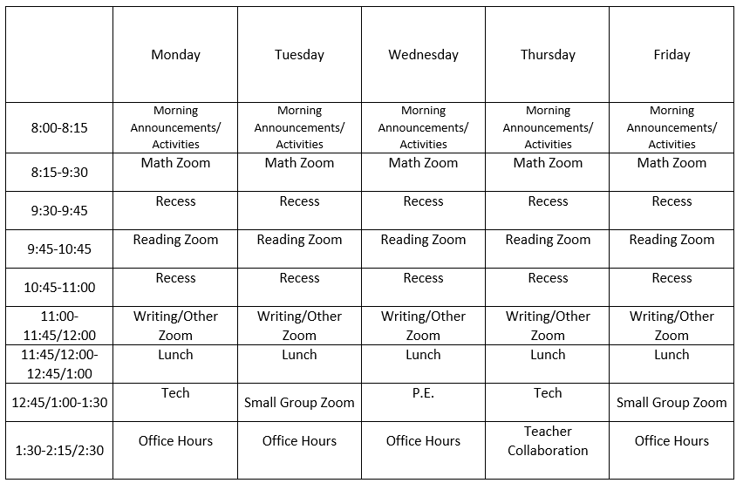
Synchronous vs. Asynchronous
 | Category 1 | Category 2 | Category 3
Subject 1 | 2,450 | 4,223 | 1,600
Subject 2 | 3,995 | 864 | 12,042
Subject 3 | 75 | 80 | 90
Subject 4 | 5,625 | 4,805 | 541
Subject 5 | 642 | 8,511 | 75
Example of a 3rd grade Daily Schedule: Ms. Dighero

Slide 5
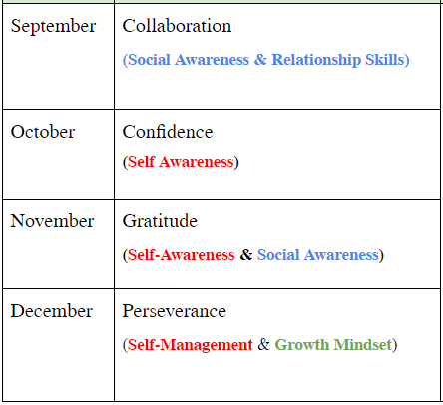
Social Emotional Learning
Monthly Themes
Mini Lessons
Focus on Engagement
Please reach out if you need support with regard to your child’s Social-emotional wellness

Slide 6
DRESS CODE
Dress Code
Please wear clothes. Tops and bottoms
We ask that students not wear PJ’s
Please make sure all pets are securely outside of the video frame and no toy sharing unless directed by your teacher
If you would like to wear uniforms, you are welcome to but it is not required at this time.

Slide 7
Attendance & Website Info.
Attendance
Please call all absences into the office if your child is out for any reason
916-395-4685 press 1 for attendance hotline
Phoebehearst.org
Grade Level Supply Lists
Teacher Amazon Wish Lists
Front office and Teacher contact information
All my communication goes on there as well

Slide 8
Contact Principal Pechette
Michelle Pechette
michelle-pechette@scusd.edu
Cell – 916-752-3596

Slide 9
Thank You!
Q & A

